Slide 1
Identify Factors That May Cause Employees To Leave The Company
By
Putri Vina Fajriyani
Linkedln : Putri Vina Fajriyani
Email : putri.vinafajriyaniale16@gmail.com

Slide 2
Problem Research
The company is currently being hit by a big problem, many employees are submitting resignations. Here I want to help the company to explain the current condition of its employees, as well as explore the problems that exist in the company that cause employees to resign so as to reduce the resignation rate of employees, and can outline a strategy that can increase the retention of employees.

Slide 3
Data Pre-Processing
Checking the contents of the dataset
The dataset contains 25 columns with data types float 5, integer 2, object 18 with a total of 287 rows among others:
Username SkorKepuasanPegawai
EnterpriseID JumlahKeikutsertaanProjek
JenisKelamin JumlahKeterlambatanSebulanTerakhir
StatusKepegawaian JumlahKetidakhadiran
Pekerjaan NomorHP
JenjangKarir Email
PerformancePegawai TingkatPendidikan
AsalDaerah PernahBekerja
HiringPlatform IkutProgramLOP
SkorSurveyEngagement AlasanResign
TanggalLahir TanggalHiring
TanggalPenilaianKaryawan TanggalResign

Slide 4
The number of unique values in each column
Username: 285 JumlahKeterlambatanSebulanTerakhir: 7
EnterpriseID: 287 JumlahKetidakhadiran: 22
StatusPernikahan: 5 NomorHP: 287
JenisKelamin: 2 Email: 287
StatusKepegawaian: 3 TingkatPendidikan: 3
Pekerjaan: 14 PernahBekerja: 2
JenjangKarir: 3 IkutProgramLOP: 2
PerformancePegawai: 5 AlasanResign: 11
AsalDaerah: 5 TanggalLahir: 284
HiringPlatform: 9 TanggalHiring: 97
SkorSurveyEngagement: 5 TanggalPenilaianKaryawan: 127
SkorKepuasanPegawai: 5 TanggalResign: 53
JumlahKeikutsertaanProjek: 9

Slide 5
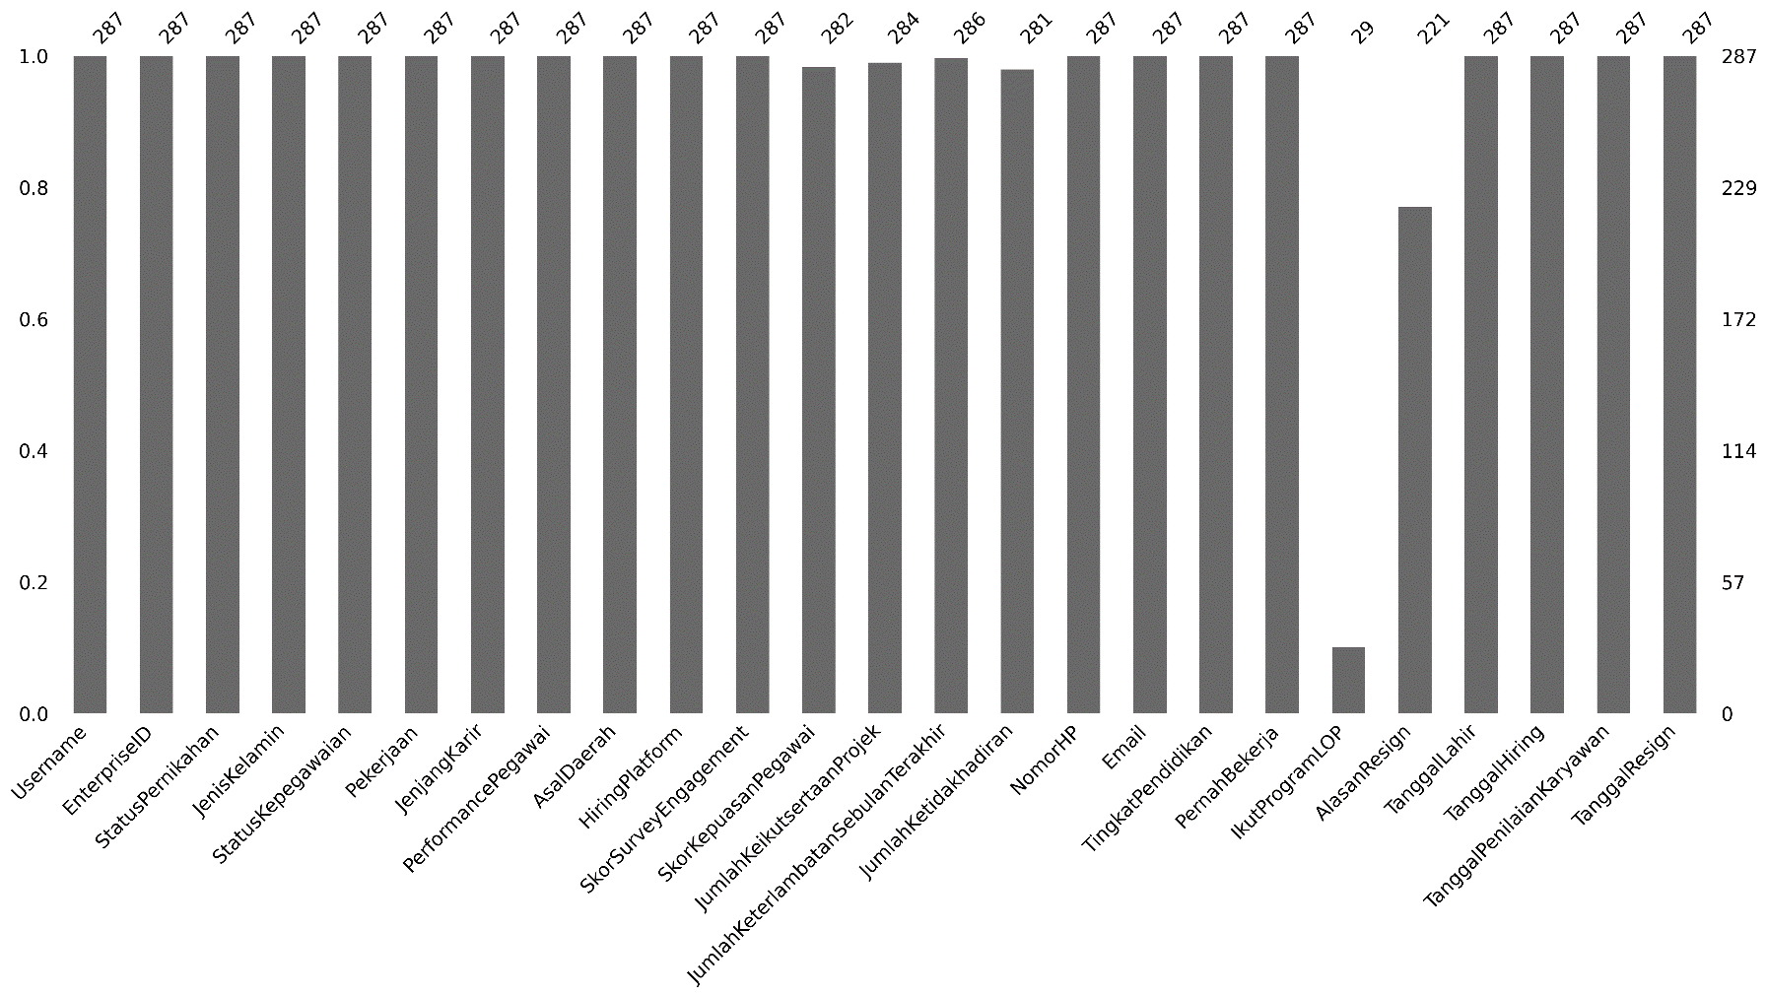
The number of missing values for each column

Slide 6
The number of missing values for each column
Kolom "IkutProgramLOP" memiliki bar yang sangat rendah (29), menunjukkan banyak data yang hilang dalam kolom ini.
Kolom "AlasanResign" memiliki bar dengan nilai sekitar 221, yang berarti ada sejumlah missing values (data yang hilang) dalam kolom ini.

Slide 7
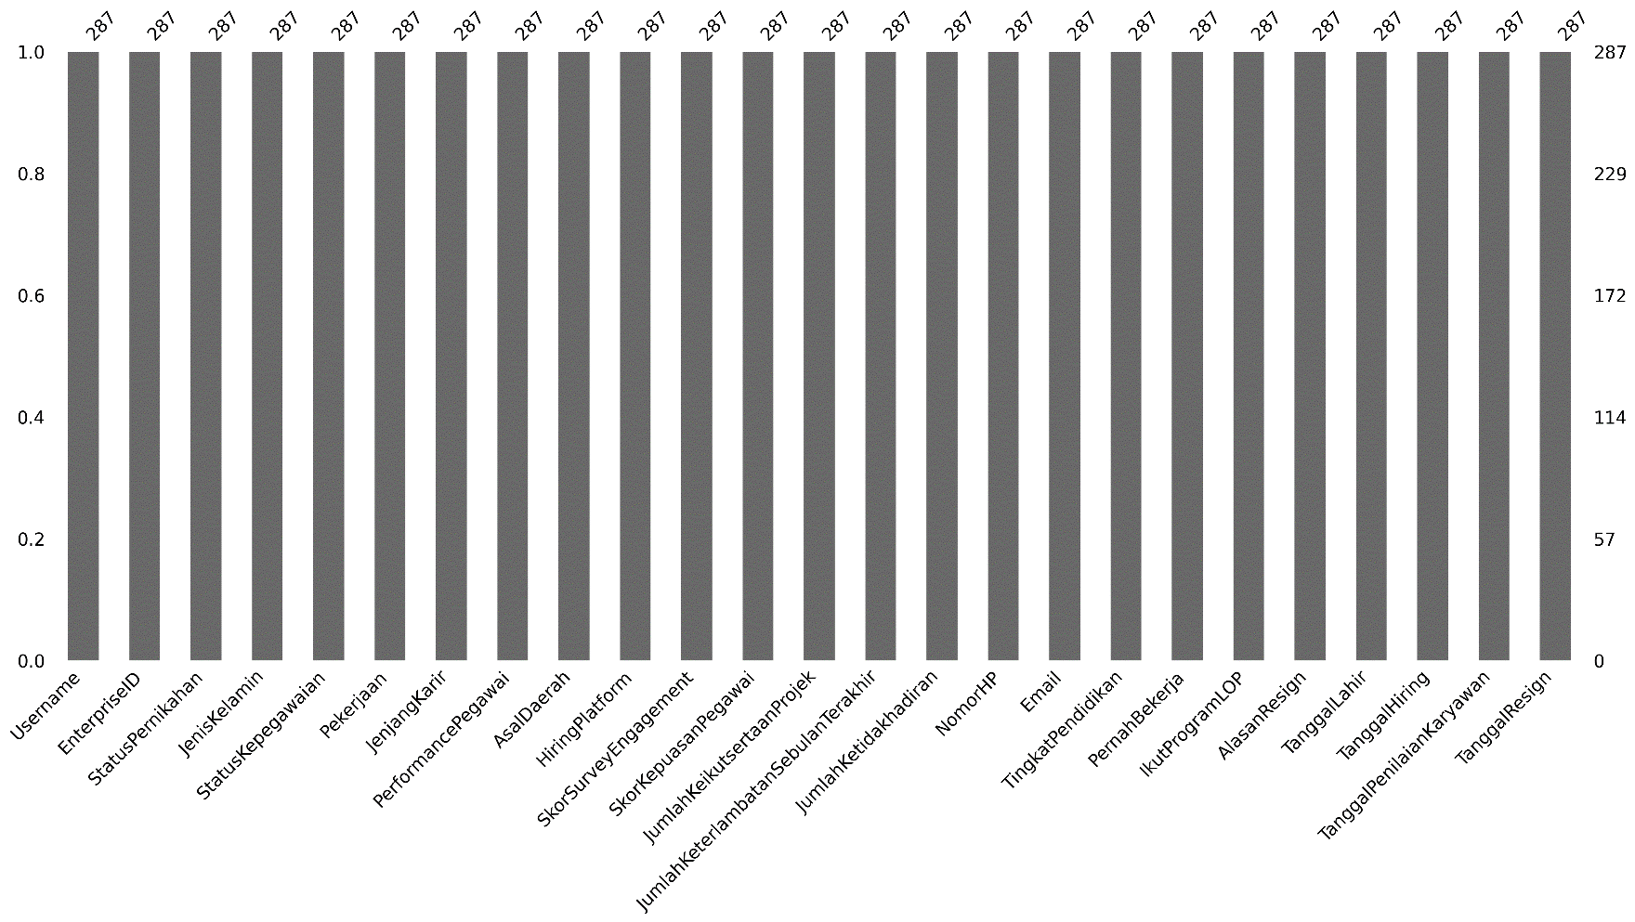
After imputation of missing values

Slide 8
Removing irrelevant variables and separating dependent and independent variables.
Dependent Variable: TanggalResign, PerformancePegawai, SkorSurveyEngagement, SkorKepuasanPegawai
Independent Variable: StatusPernikahan, JenisKelamin, StatusKepegawaian, Pekerjaan, JenjangKarir, AsalDaerah, HiringPlatform, JumlahKeterlambatanSebulanTerakhir, JumlahKetidakhadiran, TingkatPendidikan, TanggalHiring, TanggalPenilaianKaryawan, AlasanResign
To retain potential employees, the main focus is to understand the relationship between independent variables such as Status Kepegawaian, Jumlah Keterlambatan, Jenjang Karir, dan Tingkat Pendidikan, and dependent variables such as Tanggal Resign or Kinerja Karyawan.

Slide 9
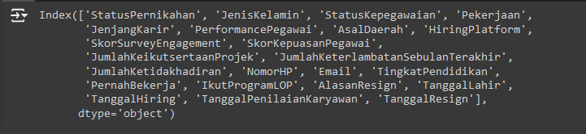
Removing irrelevant variables and separating dependent and independent variables.
In this analysis, the irrelevant columns are the Username and EnterpriseID columns, so both columns will be removed.

Slide 10
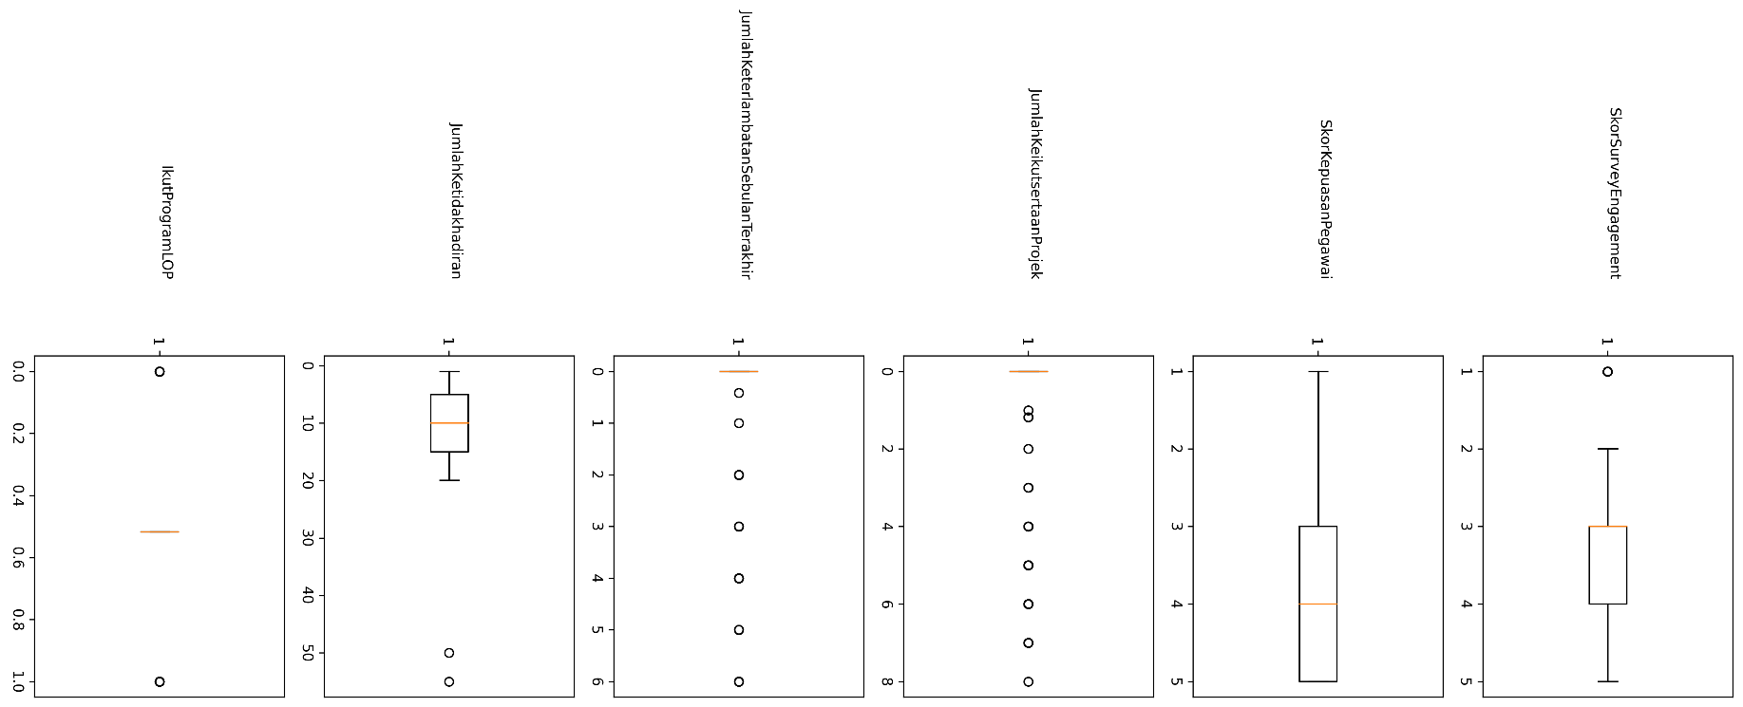
Outliers in each column

Slide 11
Outliers in each column
SkorSurveyEngagement:
The median (line inside the box) is about 3.5.
The interquartile range (IQR) includes scores of about 2.5 to 4.5.
There are outliers below 2.
SkorKepuasanPegawai:
The median is lower, around 2.
The IQR covers scores from 1 to almost 4.
There are no obvious outliers.
JumlahKeikutsertaanProjek:
The value distribution is very narrow, with the majority of the data falling between 0 and 1.
A few outliers (spheres) in the numbers 2 to 7, indicating there are employees involved in the project in significantly larger numbers than others.

Slide 12
Outliers in each column
JumlahKeterlambatanSebulanTerakhir:
Most of the values are zero.
There are some outliers of up to 6 delays.
JumlahKetidakhadiran:
The median is around 10 days.
There is a wide range of data, with outliers at 50 days.
IQR is between 5 to 15 days.
IkutProgramLOP:
The median is around 0.5, indicating that most participants fall between 0 and 1 in LOP program participation.
There are outliers at 0 and 1.

Slide 13
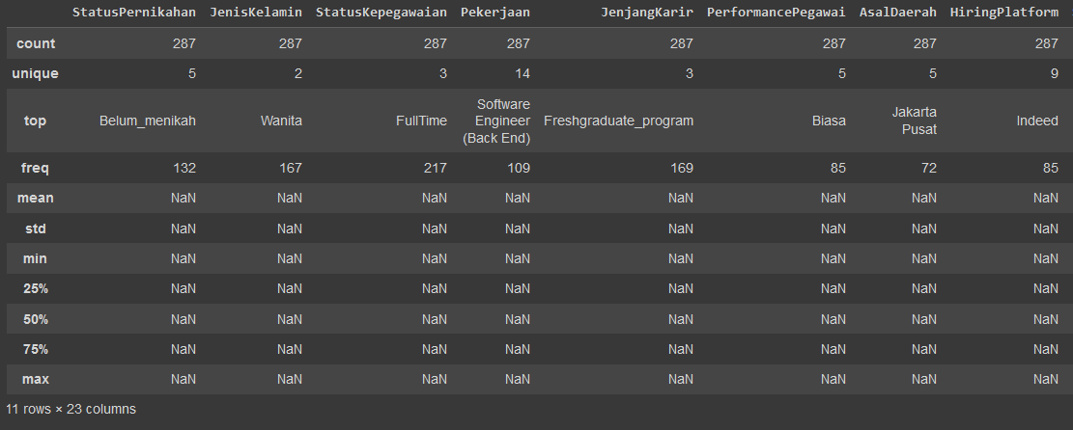
Descriptive statistics

Slide 14
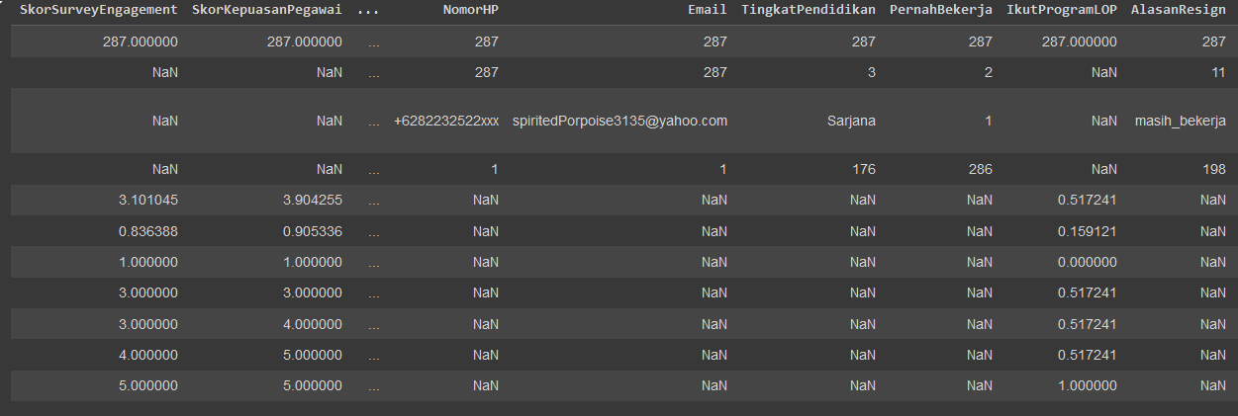
Descriptive statistics

Slide 15
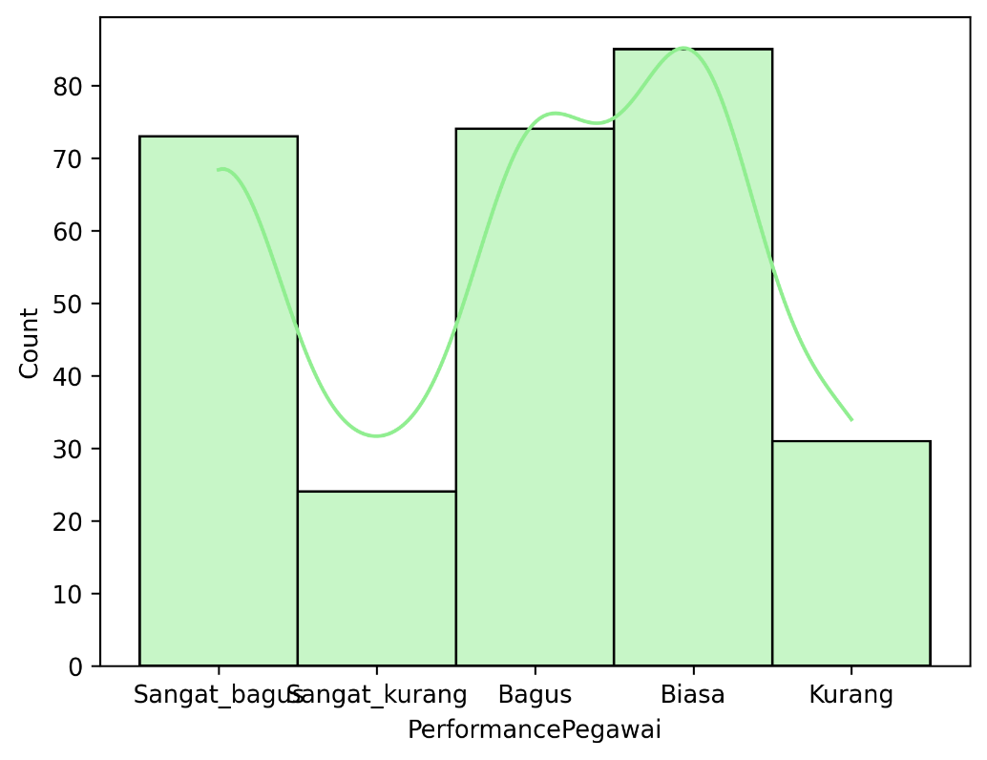
Univariate analysis
What is the distribution of employee performance scores? Are there employees with very low or very high performance?

Slide 16
What is the distribution of employee performance scores? Are there employees with very low or very high performance?
Sangat_bagus: There are about 70-80 employees who have performance "Sangat_bagus".
Sangat_kurang: Only a few employees (less than 20) are categorized as "Sangat_kurang".
Bagus: About 70-80 employees have categorized performance "Bagus".
Biasa: Number of employees with performance "Biasa" the highest, around 85-90.
Kurang: About 40 employees who fall into the performance category "Kurang".
The majority of employees are in the “Biasa” and “Sangat_bagus”, while very few employees are in the “Sangat_kurang”.
The KDE curve shows that the employee performance data is somewhat centered in the middle between categories "Biasa" and "Sangat_bagus", with a slight decrease in the "Sangat_kurang".

Slide 17
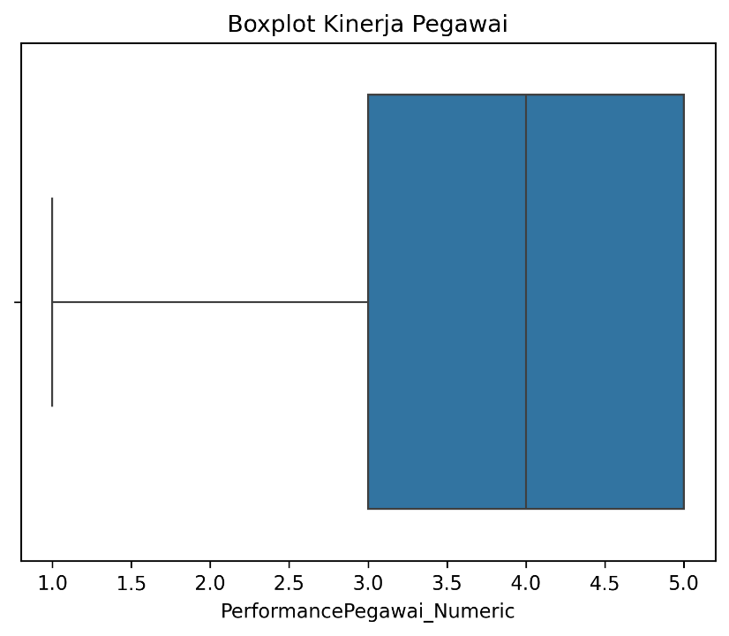
What is the mean and median of employee performance? Are there any outliers?

Slide 18
What is the mean and median of employee performance? Are there any outliers?
We can conclude a few things about employee performance that: Overall employee performance is within the range of about 1 to 5. Most employees have a performance that is around the value of 3. This can be seen from the location of the median which is around this value. The absence of outliers indicates that there is no employee performance that is very different from the others.

Slide 19
Are there significant differences in performance between groups of employees (e.g., by IkutProgramLOP, StatusKepegawaian, StatusPernikahan)?
Performing ANOVA test
Based on the values above, we fail to reject the null hypothesis. This means that there is no significant difference between the “StatusKepegawaian” with employee performance.

Slide 20
Are there significant differences in performance between groups of employees (e.g., by IkutProgramLOP, StatusKepegawaian, StatusPernikahan)?
Performing ANOVA test
Based on the values above, we fail to reject the null hypothesis. This means that there is no significant difference between employees who participated/not in the LOP program and employee performance.

Slide 21
Are there significant differences in performance between groups of employees (e.g., by IkutProgramLOP, StatusKepegawaian, StatusPernikahan)?
Performing ANOVA test
Based on the values above, we fail to reject the null hypothesis. This means there is no significant difference between the StatusPernikahan column and employee performance.

Slide 22
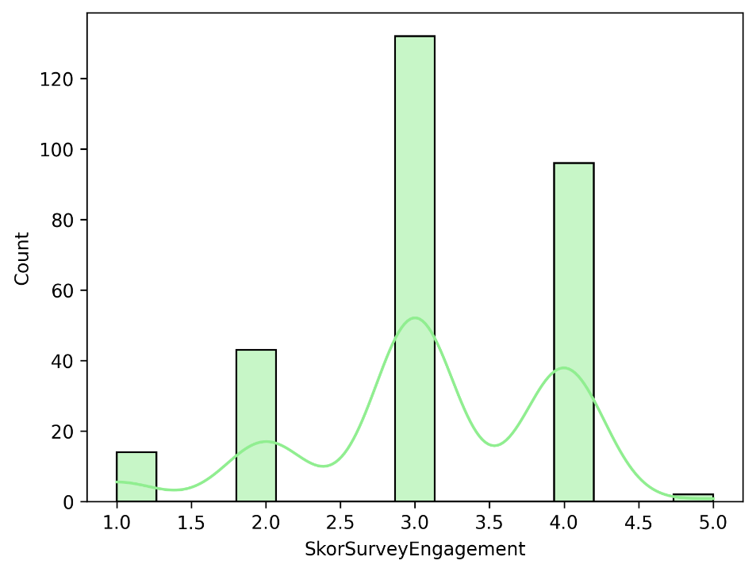
What is the distribution of employee engagement scores with the company? Do the majority of employees feel highly engaged or disengaged?

Slide 23
There are four main groups that stand out:
Score 1.0: There are relatively few employees with this score (around 20 people).
Score 2.0: There are around 40 employees with this score.
Score 3.0: This is the most frequently occurring score with more than 120 employees.
Score 4.0: Close to 80 employees.
There are almost no employees with a score of 5.0, indicating that very few employees get the highest score.
The KDE graph shows a multi-modal distribution (more than one peak), which means that there are several groups of employees with different levels of engagement.
Most employees are in the medium to high engagement category (around 3.0 and 4.0), indicating that the majority of employees have a fairly good level of engagement.
Only a few employees have very low engagement (score of 1.0), and almost none are at the maximum engagement level (5.0).

Slide 24
Is there a significant difference between employee engagement and employment status?
Performing ANOVA test
Based on the values above, we fail to reject the null hypothesis. This means that there is no significant difference between the StatusKepegawaian column and the SurveyEngagement Score.

Slide 25
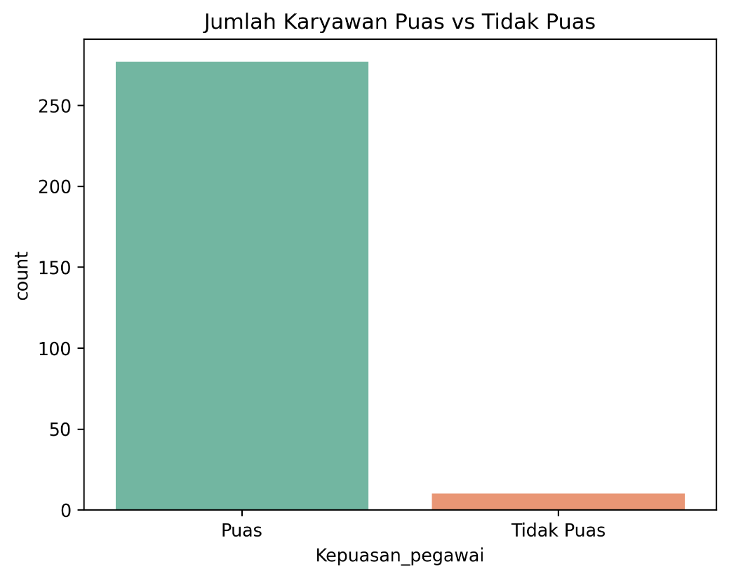
Data Visualization and Business Insight
What is the level of employee satisfaction with the company? How many employees are satisfied vs. dissatisfied?

Slide 26
What is the level of employee satisfaction with the company? How many employees are satisfied vs. dissatisfied?
The majority of employees are in the “Satisfied” category. On the vertical axis (count), it can be seen that the number of satisfied employees is more than 250 people.
Very few employees fall into the “Dissatisfied” category. Based on the graph, the number is below 50 people.
Most employees are satisfied, with only a few dissatisfied. This indicates that the level of satisfaction in this workplace is quite high.

Slide 27
What is the average number of tardies an employee has had in the past month?
From the results obtained, the average employee tardiness in the last month was 0.41 times, this shows that in general employees are rarely late.

Slide 28
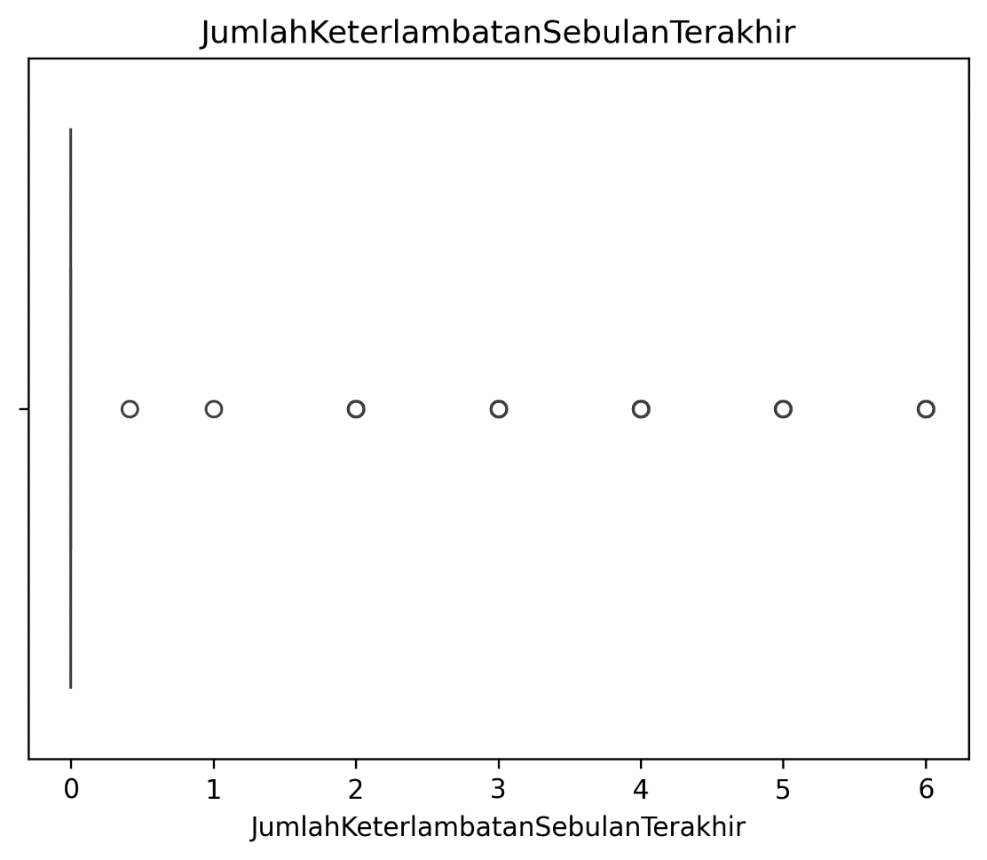
Are there any outliers in the number of employee tardiness?

Slide 29
Are there any outliers in the number of employee tardiness?
There are some points that lie far from the boxplot line, which indicates the presence of outliers. This means that there are some employees who experience much higher tardiness than others.
There is no median line in the box, indicating that the distribution of the data is skewed. The majority of employees may have a very low amount of tardiness

Slide 30
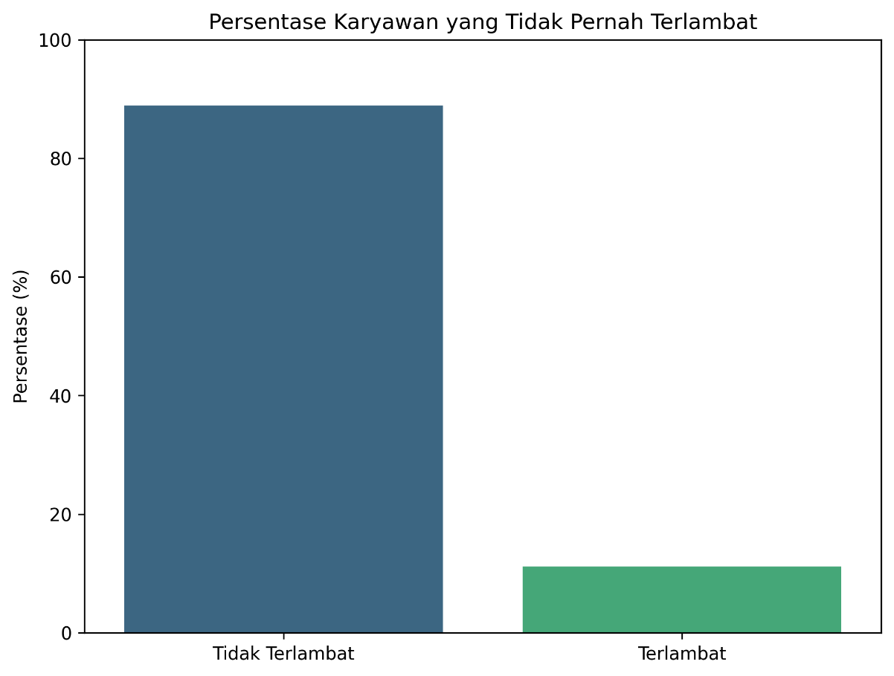
What percentage of employees are never late?

Slide 31
What percentage of employees are never late?
Based on this visualization, it can be concluded that this company has a good work culture related to punctuality. The majority of its employees show high commitment to work by always arriving on time.

Slide 32
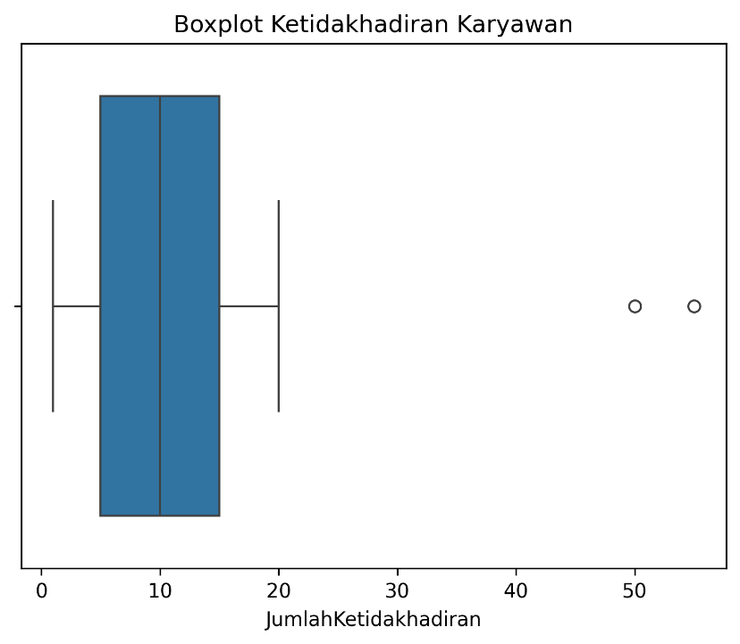
What is the distribution of employee absenteeism?

Slide 33
What is the distribution of employee absenteeism?
Most employees have a number of absences between about 5 to 15 days a year. This can be seen from the significant length of the box in that range.
The median absence is around 10 days. This means that half of the employees have less than 10 days of absence, and the other half have more than 10 days.
The inter-quartile range (IQR) is quite narrow, indicating that most of the data is concentrated in a not too wide range.
There are some employees who have a much higher than average number of absences (outliers). This is evident from the points that lie outside the upper whiskers.

Slide 34
What is the average length of employment (calculated from the date of hire)?
The average length of time employees work in the company is 3390.41 days, which is equivalent to 9 years.

Slide 35
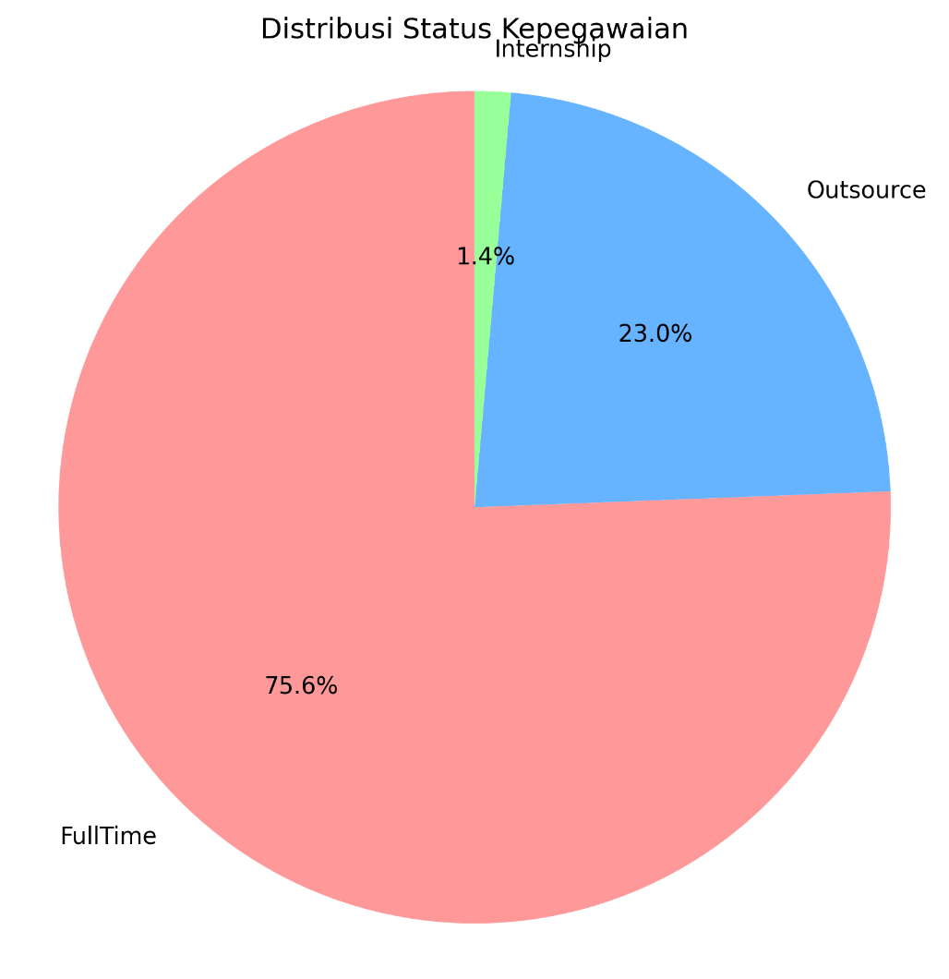
What is the percentage of Employment Status?

Slide 36
What is the percentage of Employment Status?
Full-time (75.6%): This is the largest category, meaning that the majority of employees in the company are full-time employees with 217 employees.
Outsourced (23%): This category shows that about 23% of the total employees are outsourced employees, i.e. employees who work through an outsourcing company with 66 employees.
Internship (1.4%): This smallest category shows that only a small percentage of the total employees are interns with a headcount of 4 employees.

Slide 37
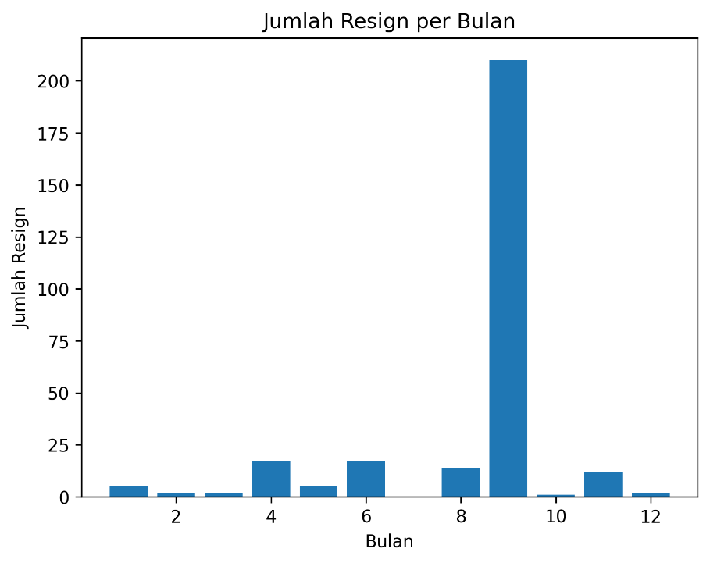
Is there a particular month that has a spike in employee resignations?

Slide 38
Is there a particular month that has a spike in employee resignations?
It can be seen that there is one month where the number of resignations is very high compared to other months, which is the 9th month (September). The number of resignations in that month reached more than 200 employees.
Other than the 9th month, the number of resignations in other months is relatively small, with the majority of months having less than 25 resignations.
The significant increase in month 9 can be considered an outlier, indicating that there was a particular factor in this month that caused the spike in resignations.

Slide 39
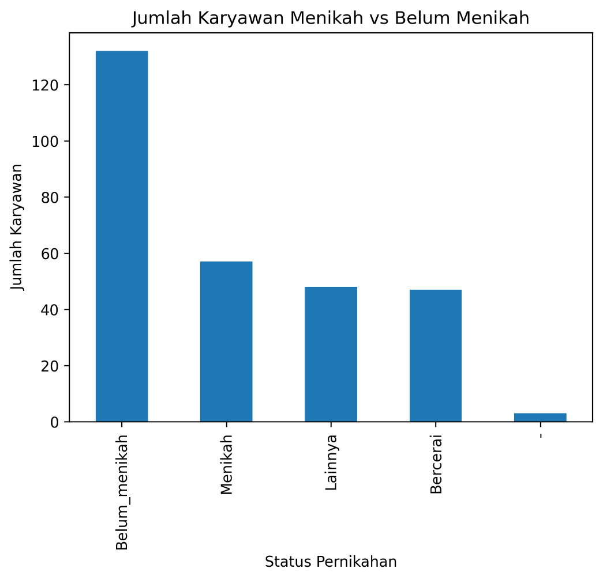
Is there a significant difference in the number of employees based on marital status?

Slide 40
Is there a significant difference in the number of employees based on marital status?
Most employees (around 120 people) are unmarried. This suggests that the majority of employees are at an early productive age or may prefer to focus on their careers before getting married.
The number of married employees is around 60. This is a significant number, indicating that there is a sizable proportion of employees who already have marital commitments.
The “other” and “divorced” categories have a much smaller number compared to the “unmarried” and “married” categories. This indicates that the number of employees with these unusual marital statuses is relatively small within the company.

Slide 41
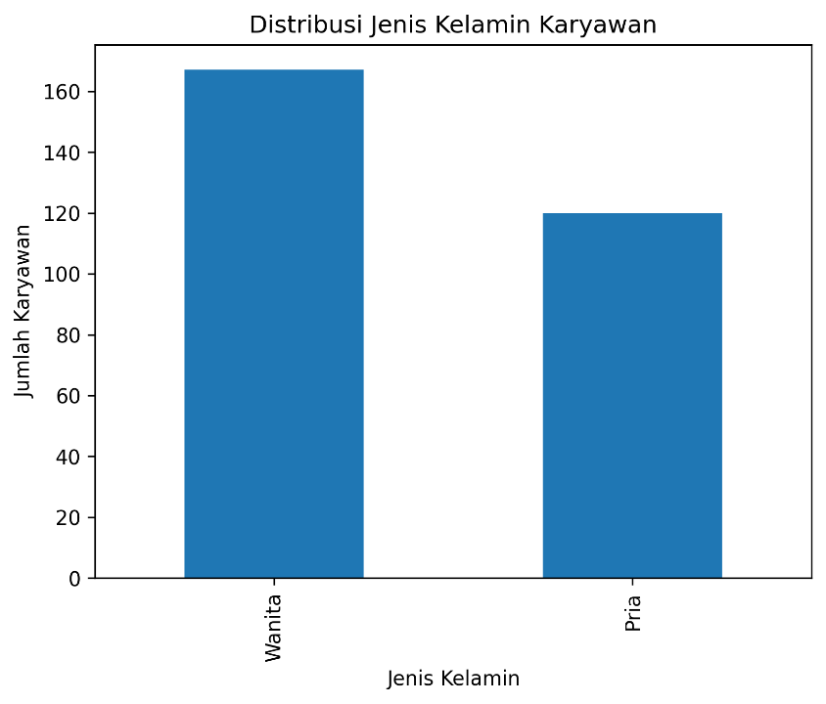
What is the gender distribution of employees?

Slide 42
What is the gender distribution of employees?
There are more female employees than male employees. It is clear that the bar representing the number of female employees is much higher at 167 employees than the bar representing male employees at 120 employees.
This significant difference in numbers indicates that the majority of employees are female.

Slide 43
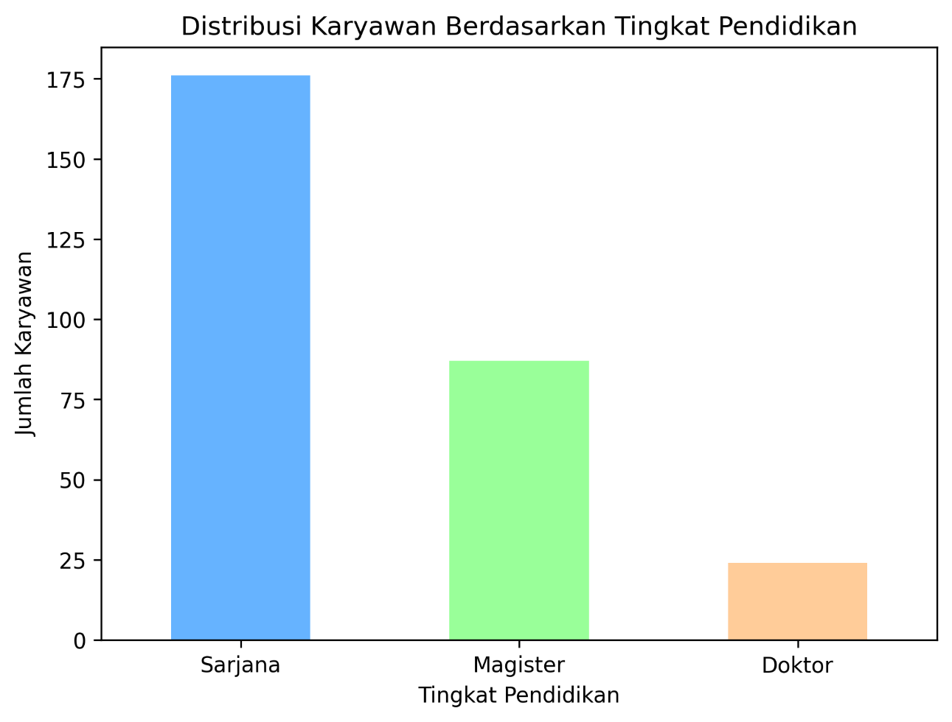
How many employees are there at each education level?

Slide 44
How many employees are there at each education level?
The majority of employees (175 people) have a bachelor's degree. This indicates that companies tend to recruit employees with a minimum academic qualification of S1.
The number of employees with master's degrees is quite significant (around 85 people). This indicates that the company also values employees with postgraduate education.
The number of employees with doctoral degrees is the least (around 25 people). This may be because there are relatively fewer positions that require doctoral qualifications or other specific requirements that limit the number of candidates.

Slide 45
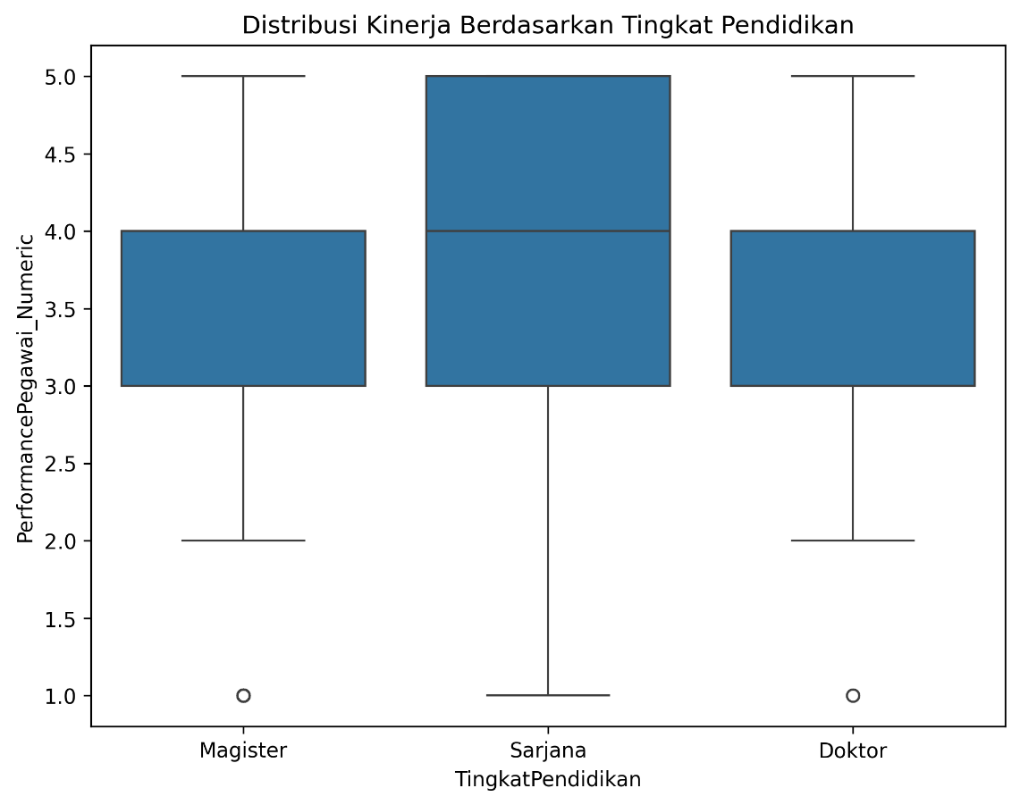
Is there a significant relationship between education level and employee performance?

Slide 46
Is there a significant relationship between education level and employee performance?
Bachelor's degree: Employees with a bachelor's degree have the widest range of performance, with a high maximum value. This shows that there are some bachelor's degree employees with excellent performance, but also some who are less good.
Masters: Master's employees perform fairly well, with a slightly higher median compared to bachelor's employees. However, the performance range is narrower, which indicates a higher level of consistency in performance.
Doctorate: Doctoral employees perform moderately well, with medians similar to those of master's employees. However, there are some outliers (extreme values) that are quite far from the rest of the data range.
Anova test is then conducted with the results Since the p-value (0.5167) is greater than 0.05, we fail to reject the null hypothesis. That is, there is not enough evidence to state that there is a statistically significant difference between employee performance based on education level.

Slide 47
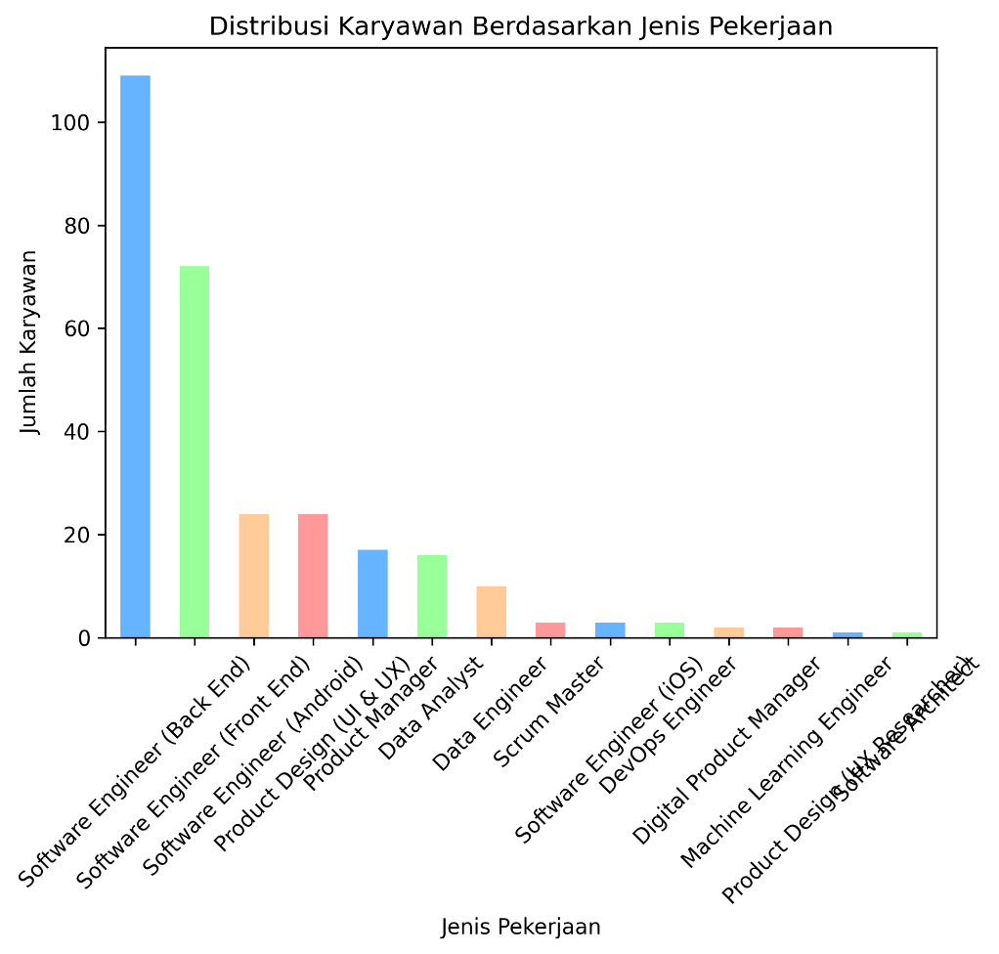
What is the distribution of employees across different types of jobs?

Slide 48
What is the distribution of employees across different types of jobs?
The job with the highest number of employees is Software Engineer (Back End). This indicates that the company has a great need for experts in the field of back-end software development.
The Software Engineer (Front End) job also has a significant number of employees. This indicates that companies are also focusing on developing the user interface of their products or services.
Other jobs such as Product Designer, Data Analyst, and Data Engineer also have a significant number of employees. This shows that the company pays attention to aspects of product design, data analysis, and data management in its operations.
Some jobs have relatively few employees, such as Scrum Master, DevOps Engineer, and Machine Learning Engineer. This may be because the need for these positions is more specific or the number of projects associated with these roles is still limited.

Slide 49
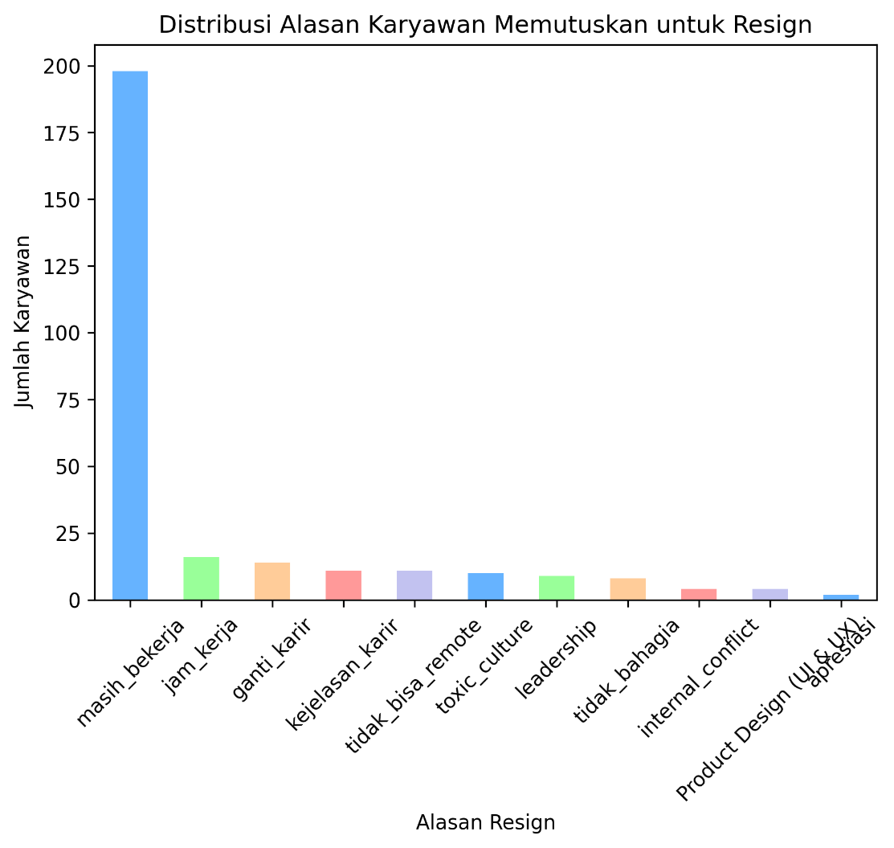
What are the main reasons employees decide to resign?

Slide 50
What are the main reasons employees decide to resign?
Main Reason: The main reason employees resign is because they are still working at the company (shown by the highest bar). Other Popular Reasons: Aside from the “still working” reason, other reasons that are mentioned quite frequently are “working hours” and “changing career”. This shows that high workload and the desire to pursue new opportunities are the main driving factors for employees to resign.
Company Culture Factors: Reasons such as “toxic culture” and “leadership” show that unhealthy working conditions and poor leadership are also reasons why employees decide to leave.
Other Factors: Reasons such as “career clarity”, “can't be remote”, “internal conflict”, and “unhappy” also illustrate that lack of career certainty, work flexibility, internal conflict, and general dissatisfaction with work can drive employees to resign.
From this visualization, it can be concluded that the reasons for employee resignation are very diverse, but can generally be grouped into several main categories:
Workload: Long and unbalanced working hours are one of the main factors.
Job Satisfaction: Lack of job satisfaction, in terms of salary, career path, and work environment, is also a major cause.
Company Conditions: Toxic company culture, poor leadership, and uncertainty about the future of the company also encourage employees to look for new jobs.

Slide 51
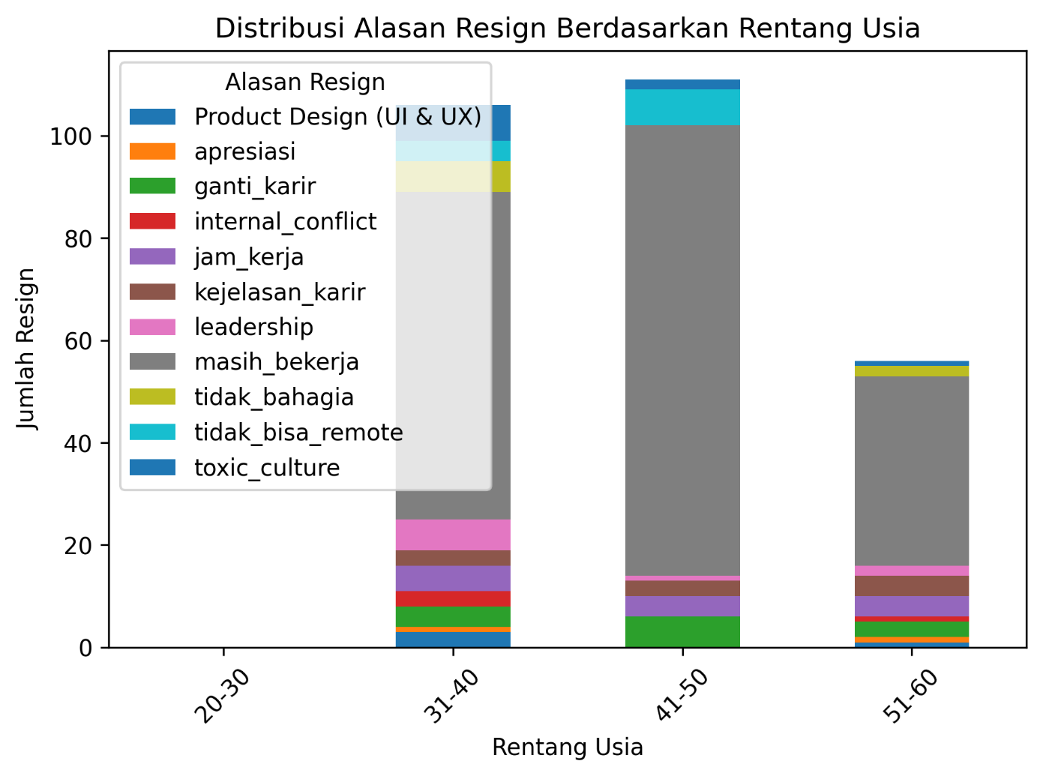
What is the distribution of resignation reasons by Age?

Slide 52
What is the distribution of resignation reasons by Age?
The 31-40 year old and 41-50 year old age ranges seem to be the groups with the highest number of resignations with the dominating reasons being not being able to work remotely, toxic work environment and leadership issues.

Slide 53
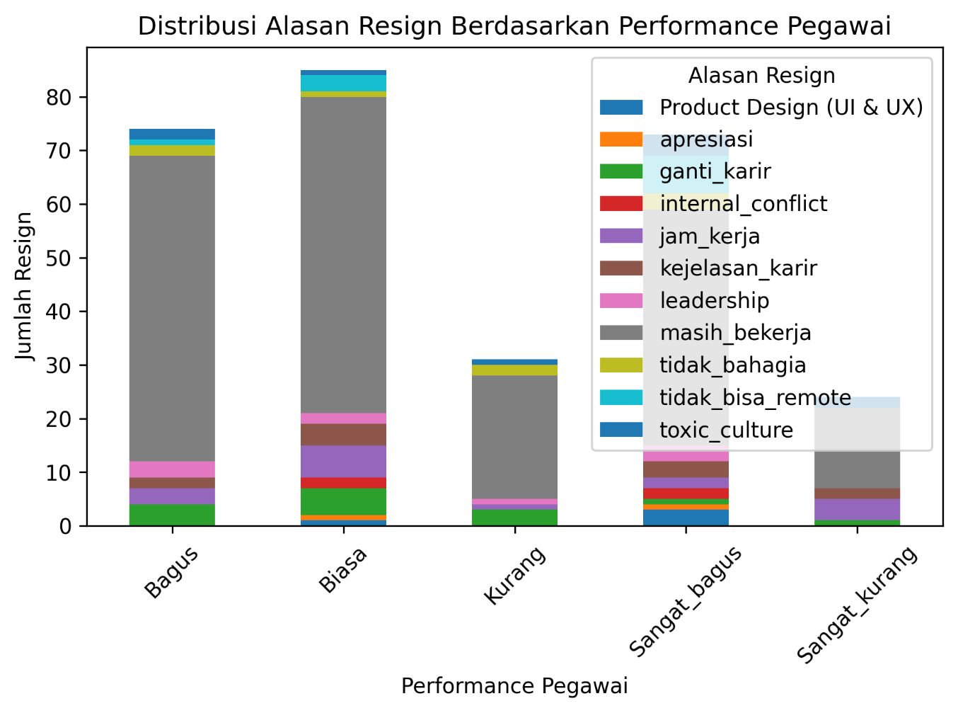
What are the reasons for employee resignation based on Employee Performance?

Slide 54
What are the reasons for employee resignation based on Employee Performance?
Employees with “average” and “poor” performance: Tend to resign more for reasons of “working hours”, “unhappiness”, and “toxic culture”. This suggests that high workload, dissatisfaction with work, and an unhealthy work environment are the main driving factors for mid-to-low performers.

Slide 55
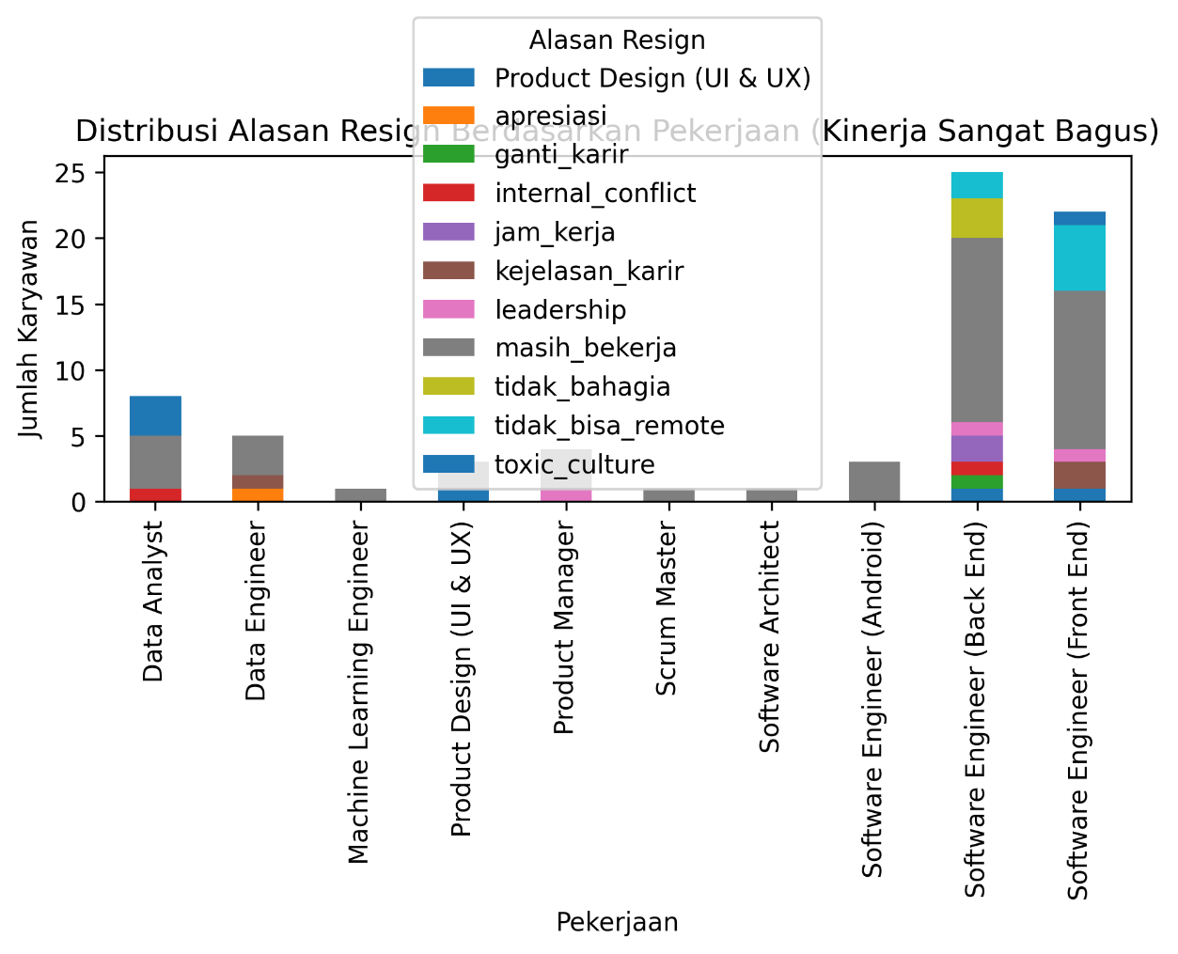
What are the reasons for employee resignation based on Employee Performance?

Slide 56
What are the reasons for employee resignation based on Employee Performance?
Highly performing employees tend to resign more due to reasons of not being able to be remote, toxic culture within the company and leadership issues. This suggests that restrictive work-from-home policies, poor leadership, and an unhealthy work environment are the main driving factors for high performers.

Slide 57
Thank You
Link Google Colab

